Slide 1
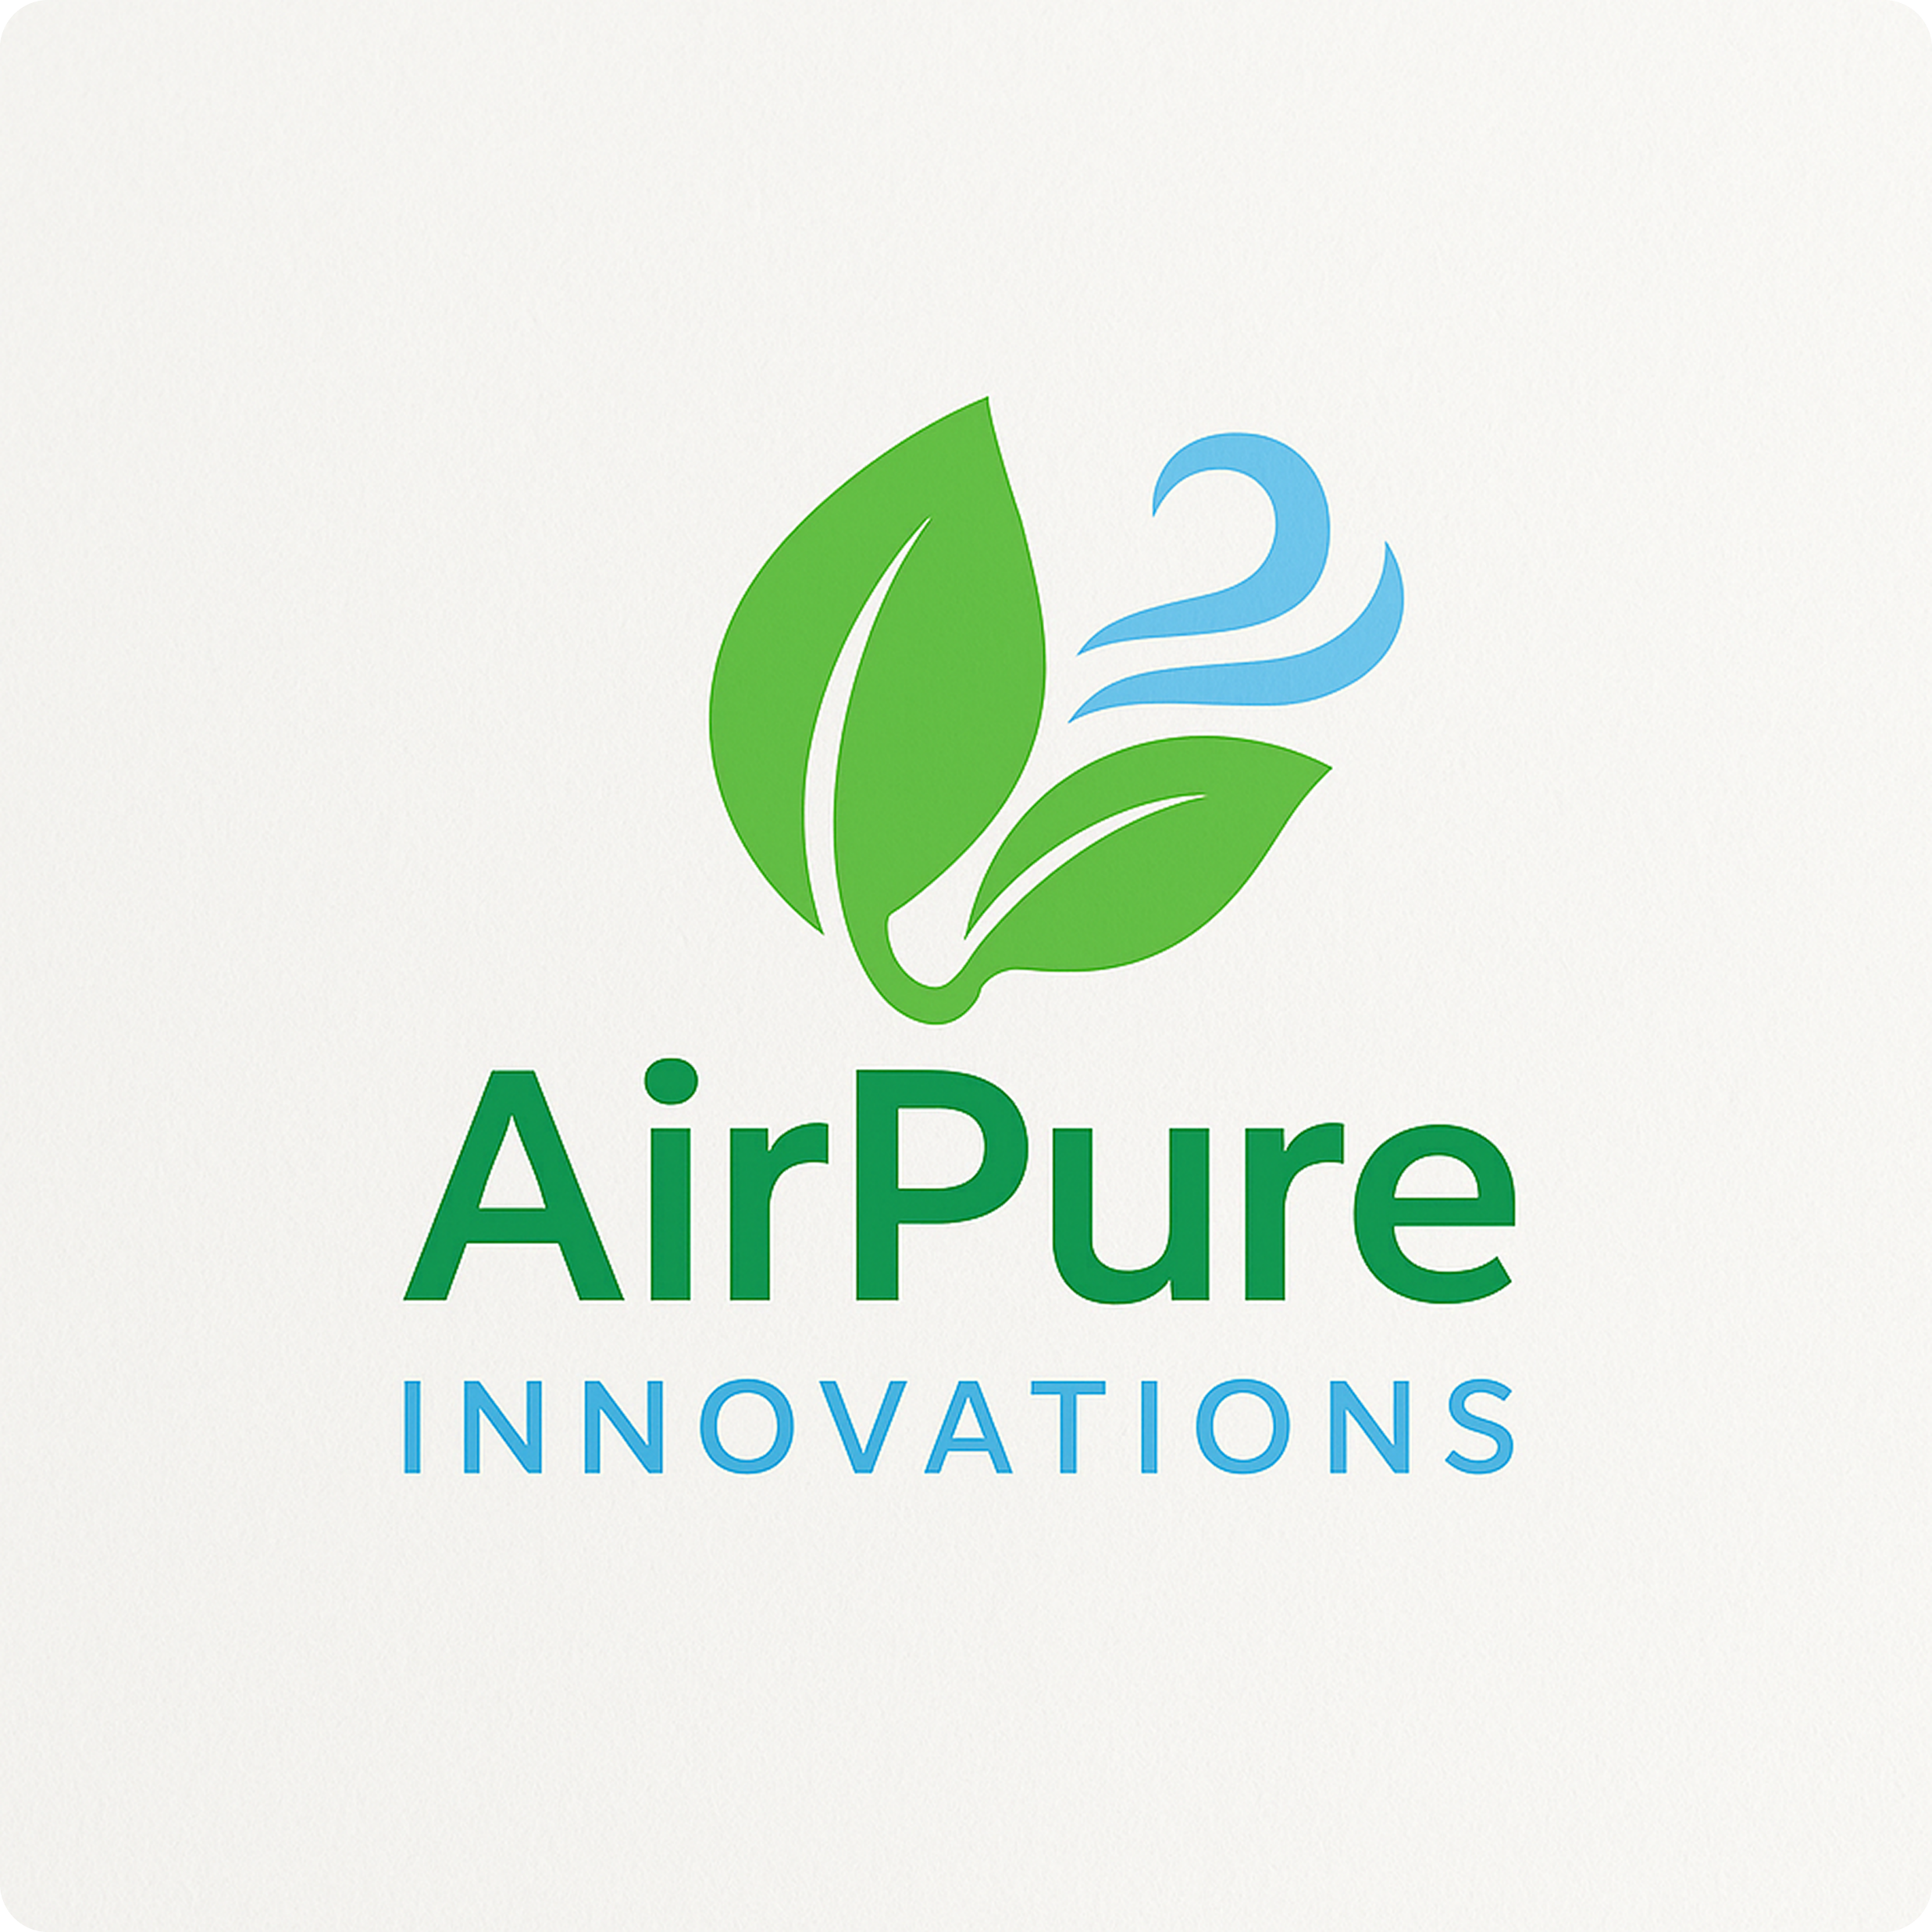
Targeting the Invisible: Pollutant-Focused Market Fit Study for
AirPure
Notes:
Hi, I am Bhimashankar the purpose of this analysis is to evaluate the Market Fit for AirPure Innovations’ upcoming air purifier product by leveraging AQI (Air Quality Index) analytics.
## Click on Notes (bottom side) for key observations.

Slide 2
Problem Statement
AirPure Innovations is an emerging startup focused on addressing the growing air quality crisis through innovative air purification solutions. At this early stage of product development, the company seeks to validate long-term market demand before committing significant resources to production and R&D.
To inform product strategy and go-to-market planning, this analysis aims to answer four critical questions:
Pollutant Prioritization. Which pollutants (Pm2.5, NO₂) are most prevalent across different regions.
Feature design. What features Air purifier must have (Smart sensors, HEPA filters, energy efficiency) & how these preferences vary by geography or consumer segment?
Demand mapping. Which cities has highest demand for air purifiers based on pollution levels, health impact, population density and income levels?
Localized R&D strategy. How can product R&D be aligned with region-specific pollution patterns.
Notes:
The goal is to assist AirPure Innovations, a startup tackling India’s air quality crisis, in identifying:
Key pollutants to target.
High-demand cities.
Recommended product features by region.
Strategy-aligned R&D directions.

Slide 3
Primary Analysis

Slide 4
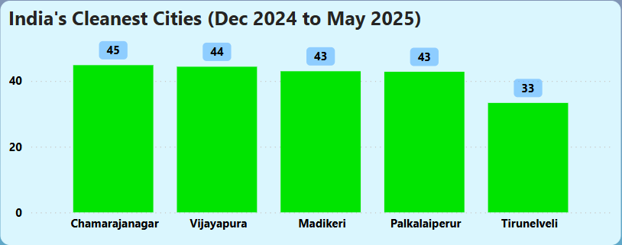
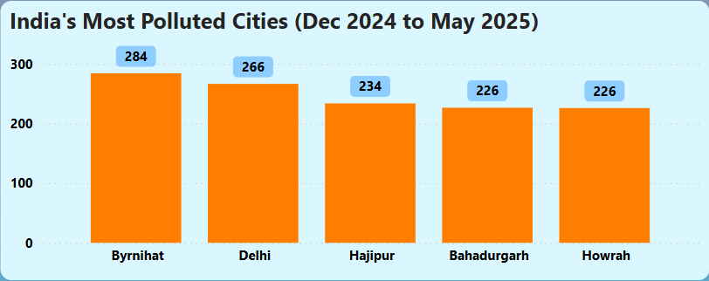
01. List the Top 5 & Bottom 5 areas with highest average AQI (December 2024 to may 2025).
Notes:
Let's start with primary analysis.
Top 5 & bottom 5 areas with highest average AQI.
Byrnihat small industrial town located on the Meghalaya-Assam border is most polluted cities in India during (Dec 24 to May 25) mainly due to cement factories, coal transportation from nearby mines & pollution trapped in hilly terrain.
Most common reason for other cities are industrial emissions, old vehicles and lack of pollution control measures.
Regarding Cleanest cities Chamarajanagar, Vijayapura, Madikeri etc have AQI below 50 mainly because of Low vehicular & industrial emissions. Ample green cover, favourable wind & weather conditions aiding dispersion.

Slide 5
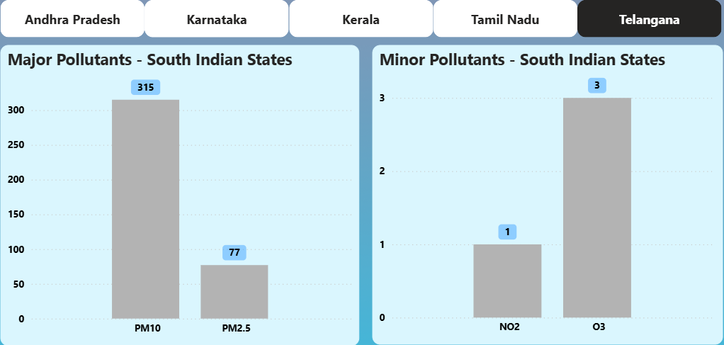
02. List out top 2 & bottom 2 prominent pollutants for each state of southern India(2022 onwards)
Notes:
Pollutant Trends in Southern States (2022 Onward).
Across all southern states, PM10 is the most prominent pollutant, followed by PM2.5, indicating high particulate matter concentration. An exception is Karnataka, where CO (Carbon Monoxide) dominates due to urban traffic emissions.
Bottom pollutants across South India with NO₂ appearing in Andhra Pradesh, Karnataka and Telangana and NH₃ in Karnataka, Kerala, and Tamil Nadu. SO₂ is limited to Andhra Pradesh and Kerala while O₃ is among the least prominent only in Tamil Nadu and Telangana.

Slide 6
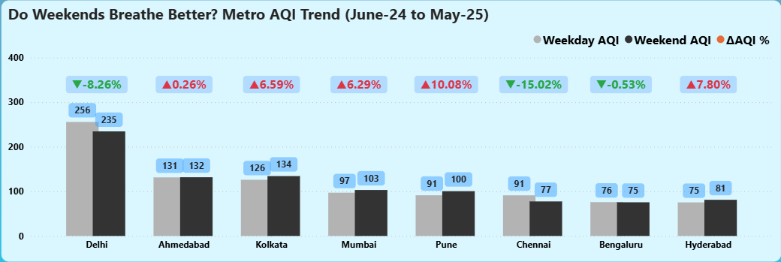
03. Does AQI improve on weekends vs weekdays in Indian metro cities (Delhi, Mumbai, Chennai, Kolkata, Bengaluru, Hyderabad, Ahmedabad, Pune)? (Consider data from last 1 year)
Notes:
Do AQI value improve on Weekends??
For cities like Delhi, Chennai there is drop in AQI value compared to Weekday may be due to decrease in Industrial activities, reduced traffic.
While for Pune, Mumbai, Kolkata, Hyderabad AQI value is more than on Weekdays especially for Pune (10%) mainly due to increase in traffic on weekends.

Slide 7
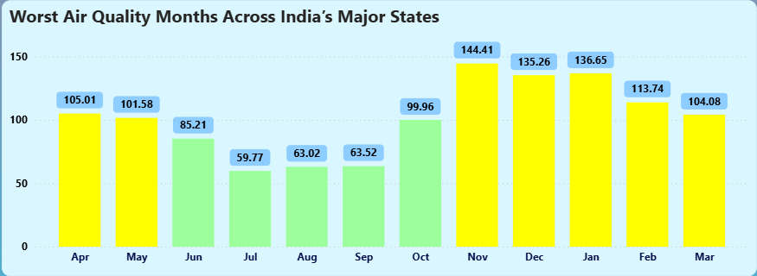
04. Which months consistently show the worst air quality across Indian states
(Consider top 10 states with high distinct areas)
Notes:
Months that consistently show the worst (Moderate 101-200) air quality across Indian states is November to January (peak November) mainly due to stubble burning, winter season and festivals.
While June to October show relatively better air quality.
Top 10 states with high distinct areas: Andhra Pradesh, Chhattisgarh, Gujarat, Karnataka, Madhya Pradesh, Maharashtra, Odisha, Rajasthan, Tamil Nadu, Uttar Pradesh.

Slide 8
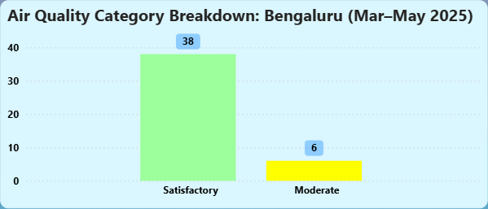
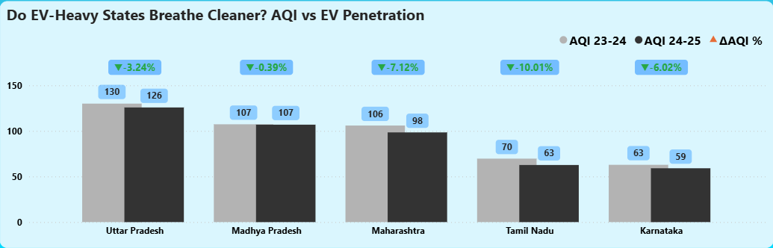
05. For the city of Bengaluru, how many days fell under each air quality category (e.g., Good, Moderate, Poor, etc.) between March and May 2025?
06. List the top 5 states with high EV adoption and analyse if their average AQI is significantly better compared to states with lower EV adoption
Notes:
Between March & May 2025 for Bengaluru city majority of days fall under Satisfactory (38 days), suggesting manageable pollution, while Moderate(6 days).
Do EV adoption has positive link with Pollution??
We compared AQI data from 2023–24 and 2024–25 in the top 5 EV-adopting states (2023-240 sales):Uttar Pradesh, Maharashtra, Karnataka, Tamil Nadu, and Madhya Pradesh.
Karnataka, Maharashtra & Tamil Nadu show notable AQI improvement (>5%) alongside rising EV adoption, suggesting a potential positive link between EV penetration & improved air quality.
In contrast Uttar Pradesh and Madhya Pradesh show limited AQI improvement with Madhya Pradesh showing minimal change possibly due to slower EV infrastructure rollout or other dominant pollution sources.
While EV penetration appears to support better air quality, it is one of several influencing factors along with weather patterns, enforcement of emission standards.

Slide 9
Secondary Analysis

Slide 10
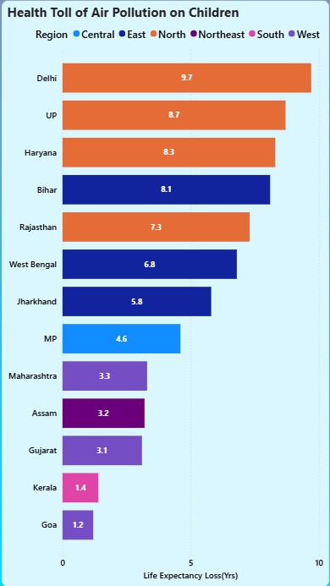
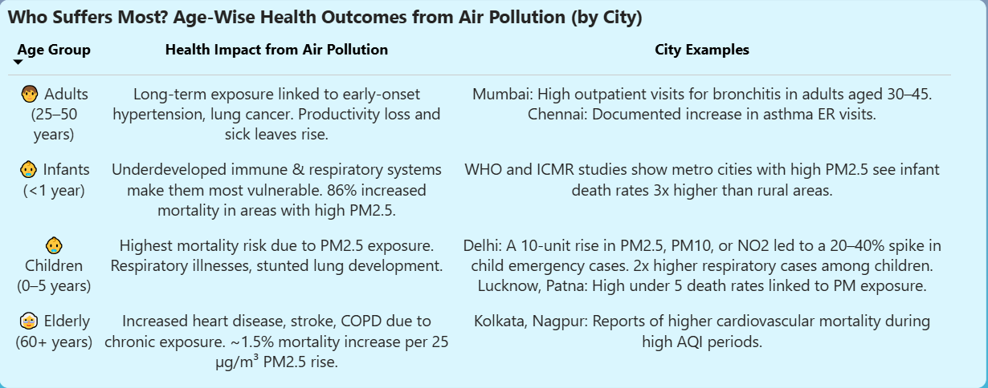
01. Which age group is most affected by air pollution-related health outcomes & how does this vary by city?
Notes:
Who Suffers Most from Air Pollution?
Infants(<1 years), Children (0-5 years) & Elders (60+ years) suffers most.
Why Children Vulnerable??
AIIMS Expert: Children breathe faster & are closer to the ground, Immature immune systems & Developing lungs, Greater outdoor exposure during school/playtime.
“Long-term exposure to poor air quality stunts lung development & increases respiratory risks in children.”
Study conclude if there is an 10-unit increase in PM 2.5, PM 10 or NO2 levels in DELHI there was a corresponding 20–40 % increase in the number of children landing up in the Emergency.
2nd Visual shows effect of air pollution on Life expectancy of Children.
Worst impact seen in Delhi (9.7 yrs), followed by Uttar Pradesh (8.7 yrs) and Haryana (8.3 yrs). North and Central Indian states are most affected.
While Elderly (65+) & Adults with Pre-existing Conditions.
Higher risk of Chronic Obstructive Pulmonary Disease (COPD), Heart disease, Strokes, Pollution exacerbates Hypertension, Diabetes, and Cardiac conditions.
Study conclude Kolkata, Nagpur report higher cardiovascular mortality during high AQI periods.
Chennai city documented increase in Asthma patient with increase in pollution.
## Source (2nd visual): Air Quality Life Index by the Energy Policy Institute, University of Chicago, 2023; National Family Health Survey (NFHS-5), 2019-2021.

Slide 11
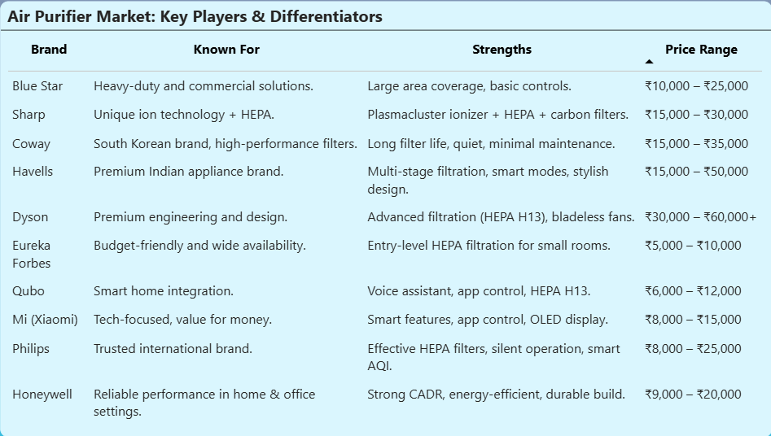
02. Who are the major competitors in the Indian air purifier market, and what are their key differentiators (e.g., price, filtration stages, smart features)?
Notes:
Major competitors in the Indian air purifier market & key differentiators.
Brand are differentiated based on filtration type/stages (HEPA, Carbon filters), noise levels & smart features(OLED Display, filter change sensors).
Mi & Eureka Forbes focus budget buyers ➔ basic HEPA filter. Blue Star & Honey lead in commercial/home use ➔ Durable build quality, High CADR.
Dyson & Havells mainly cater Premium customer providing features like smart controls, advance filter(HEPA H13), stylish design.
HEPA (High Efficiency Particulate Air) filter is a mechanical air filter that captures at least 99.97% of airborne particles ≥0.3 microns.
H10–H12: Standard-grade HEPA filters with 90–99.5% efficiency. H13–H14: Medical-grade filters used in hospitals, offering 99.95–99.995% efficiency.
Clean Air Delivery Rate (CADR) is a standard metric that measures how effectively an air purifier removes pollutants from the air.

Slide 12
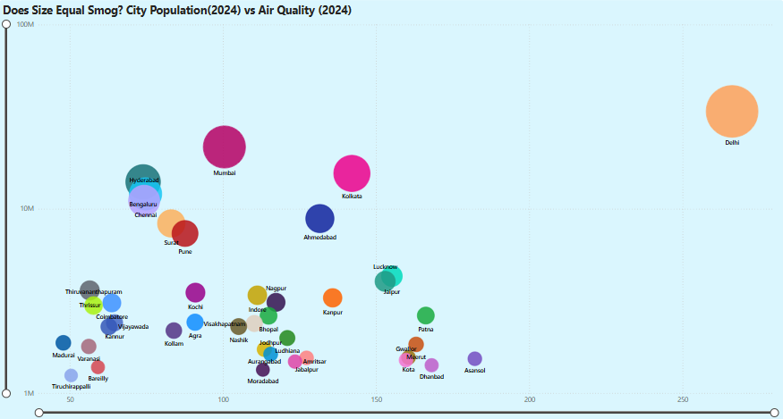
03. What is the relationship between a city’s population size and its average AQI — do larger cities always suffer from worse air quality? (Consider 2024 population and AQI data for this)
Notes:
Does Population Size Equal Smog? City Population vs Air Quality.
There is No Linear Relationship between Population & Air Quality.
Because Large populated cities like Hyderabad, Bengaluru, Chennai maintain Satisfactory AQI (50–100), while Mumbai Moderate AQI (100-150).
Smaller cities like Dhanbad, Asansol, Patna, Meerut etc have high AQI (150–200) suggesting that Pollution is not just a function of Population size.
Delhi though have high population city has AQI (250-300).
## For analysis purpose we have taken Avg AQI value 2024 & City Population (2024) .

Slide 13
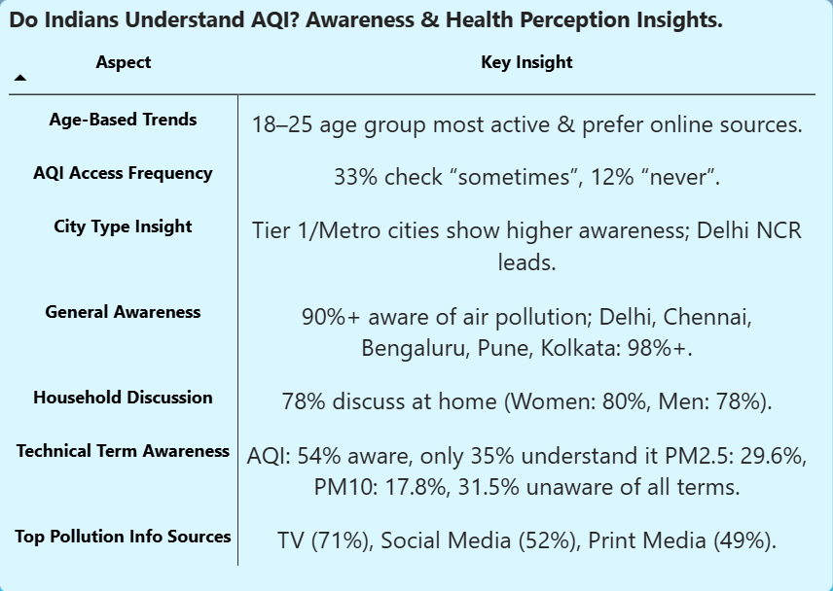
04. How aware are Indian citizens of what AQI (Air Quality Index) means — and do they
understand its health implications?
Notes:
When we talk about Awareness level about Air pollution among Indian Citizens, as per survey
General Awareness is high (90%+) especially in metro cities like Delhi, Mumbai, Kolkata etc (98%+).
But Technical Understanding is low ➔ only 54% know what AQI means & awareness about pollutants like PM2.5/PM10 is even lower.
TV, Social media & Print media are the most common sources of air pollution information.
78% of households report discussing AQI at home with higher engagement among women.
The 18–25 age group is the most active & prefer online platforms for updates.
## Source: The Clean Air Collective, in collaboration with CMSR Consultants, conducted a survey across 17 Indian cities (incl. Delhi, Kolkata, Bangalore, Pune Mumbai) interviewing 5,000 people to assess public awareness of air pollution.

Slide 14
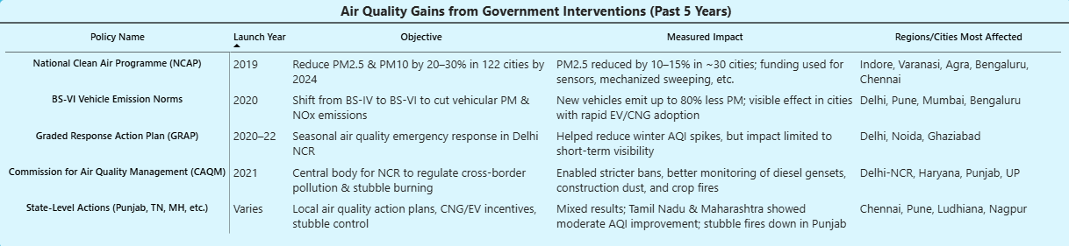
05. Which pollution control policies introduced by the Indian government in the past 5 years have had the most measurable impact on improving air quality — and how have these impacts varied across regions or cities?
Notes:
Government has taken multi-level actions to combat Air Pollution.
National Clean Air Programme (NCAP) ➔ Aim was to reduce PM2.5 & PM10 10–15% in 144 cities.
Impact ➔ In nearly 30 cities level dropped between 10-15%
Bharat Stage – VI ➔ Introduced to cut vehicular emissions by up to 80%. To accelerate clean mobility the government launched the FAME II scheme (2019–2024) a subsidy-driven initiative promoting the adoption of EVs and CNG vehicles..
For tackling severe pollution problem in Delhi.
GRAP (Graded Response Action Plan, 2020–22) ➔ Action Seasonal emergency response (ban on construction, diesel gensets etc.)
CAQM (Commission for Air Quality Management) ➔ Action Regulates diesel gensets, crop residue burning, construction dust.
For creating awareness among population about air pollution.
Introduction of Color-Graded Air Quality Index (AQI) to make pollution levels more understandable to the public. Awareness drives via media, schools and digital platforms to promote behavioural change & pollution literacy.

Slide 15
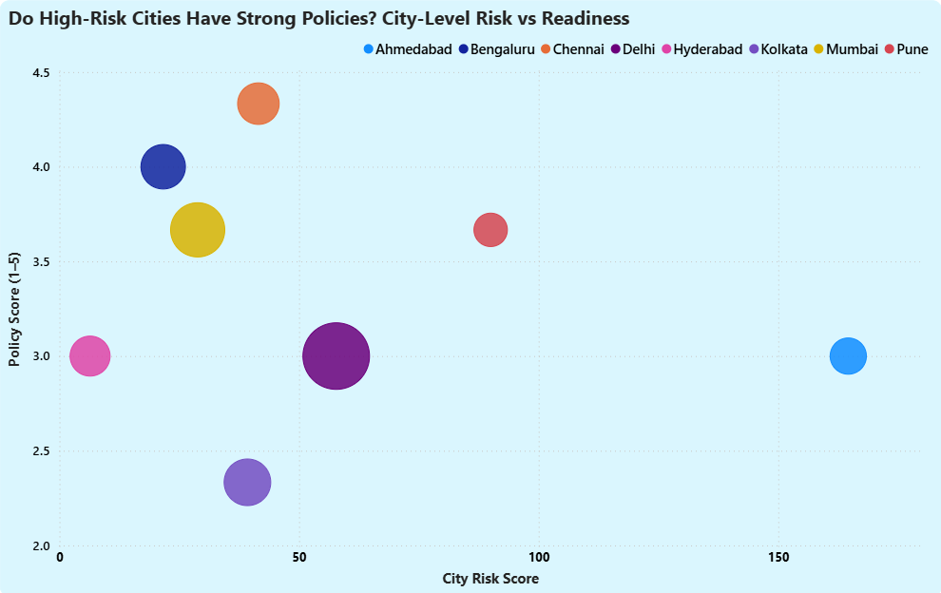
City Risk Vs Readiness.
Notes:
City Score is pollution risk at the city level calculated using normalized AQI (2024), Population Density(2024) & Per Capita Income(2024).
Risk Score = AQI × Density × (1 – Income) × 100
Policy Score is calculated based on BS-VI fuel adoption, State-led actions & NCAP implementation rated on a 1(Poor) to 5(Excellent) scale.
Aim was to plot Relationship between City Risk vs Readiness.
Key Observations:
Ahmedabad shows the highest risk score (164.62) but Moderate Policy score of 3 indicating average preparedness.
Bengaluru and Chennai demonstrate relatively low risk scores along with high Policy scores suggesting strong policy measures.
Delhi, Pune, and Mumbai fall in the middle range.
Hyderabad having the lowest risk score & moderate policy score.
Kolkata with a moderate risk score & lowest policy score indicating poor response to pollution exposure.
Why Normalization?
Scales different variables (like AQI, population density, and income) to a common range, usually between 0 and 1, this ensures fair comparison.

Slide 16
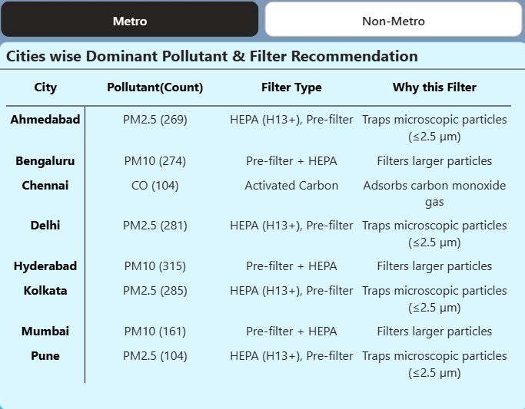
Cities Wise Dominant Polluants & Filter Recommandation.
Notes:
As shown in the visual which track Dominant pollutants by city (Metro & Non-Metro) & suggest the Air Filter type that should be used for optimal air purification.
For Particulate matters PM2.5 & PM10: Use HEPA filters (preferably H13 or H14) ➔ they offer 99.95–99.995% efficiency.
Gaseous pollutants like NO₂, SO₂, VOCs: Use Activated Carbon filters ➔ they absorb harmful gases, smoke and Odors that HEPA filters can’t trap.
For biological pollutants (Pollen, Bacteria, Mold)
Use multi-stage filtration with HEPA + UV or ionizers for broader protection.

Slide 17
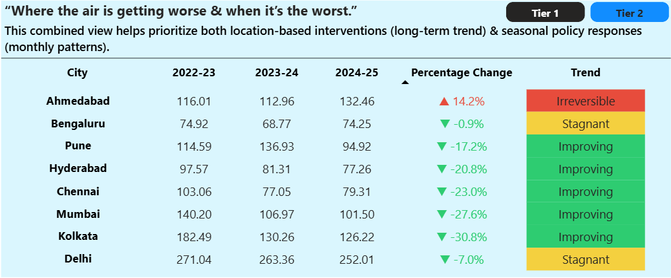
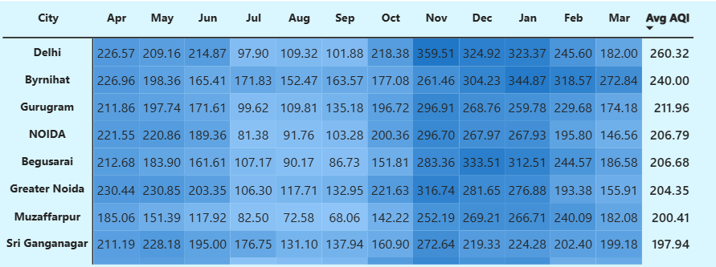
Severity Mapping:
Identify cities experiencing persistent or worsening AQI levels
Notes:
Severity Mapping: Highlighting cities where air quality is degrading.
Key Observations:
Tier 1 Cities ➔ Ahmedabad show Irreversible trend i.e. it air quality is degrading year over year, While for Bengaluru & Delhi is Stagnant.
Tier 2 Cities ➔ Jaipur, Guwahati, Nasik show Irreversible Trend.
Seasonal Pattern.
November – February : Most cities show significantly higher AQI during these months due to stubble burning, low wind speeds and temperature inversion.
July – September: AQI levels drop sharply during monsoon months, likely due to rain-driven pollutant washout.
Calculation: Air Quality Trend Classification (2022 – 2025):
Calculates percentage change in AQI to categorize city-level trends:
Improving: ≥10% reduction in AQI values.
Stagnant: Net change within ±10% threshold.
Irreversible: ≥10% increase in AQI values.

Slide 18
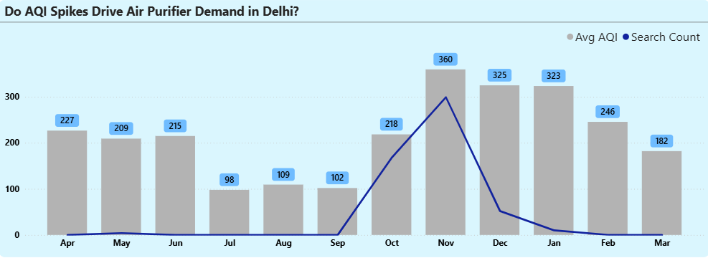
Behaviour Shifts/Demand Triggers:
Do pollution emergencies increase purifier searches/purchases?
Notes:
Behaviour Shifts: Do pollution emergencies increase purifier searches/purchases?
Yes - Clear correlation observed between AQI spikes & increased search interest.
Significant surge in “Air Purifier” Google searches during pollution emergencies.
Region: Delhi. Source: Google Trends 2024.

Slide 19
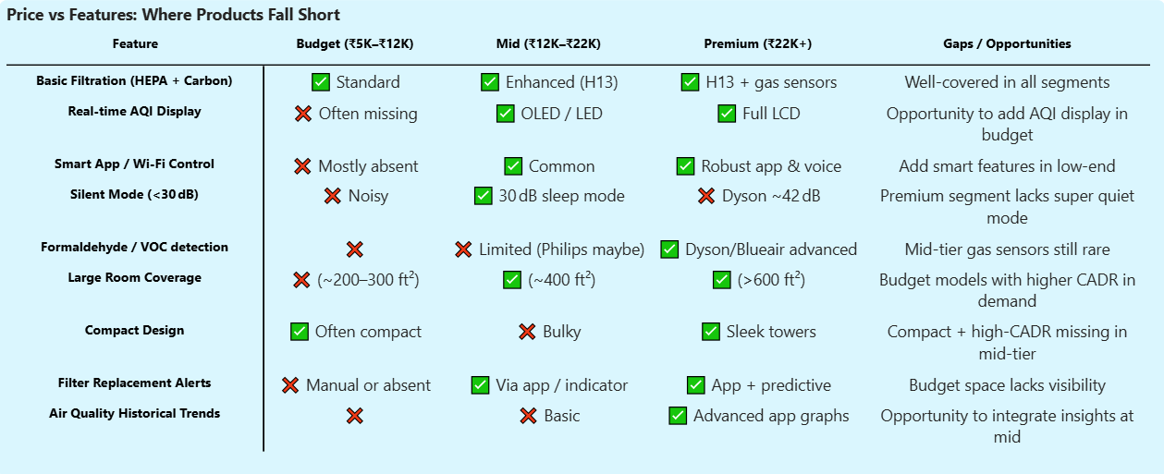
Feature Gap:
What do existing products lack (e.g., smart AQI syncing, compact designs)?
Notes:
Feature Gap based on Price: What do existing products lack (e.g., smart AQI syncing, compact designs)?
Above matrix helps to identify the Opportunities.
Budget models (≤ ₹12K): Lack smart app support, AQI Display, noise control, formaldehyde filters & room coverage.
Mid-tier (₹12K–22K): Offers balanced performance but lacks smart integration, noise suppression, bulky design.
Premium (₹22K+): Most features covered, further improvement in design.
Opportunities for Air Innovation.
Budget: Add smart features & quiet mode.
Mid-tier: Opportunity for higher CADR & Compact models.
Premium: Add insights, trends & integrate mobile app intelligence.

Slide 20
Market Prioritization

Slide 21
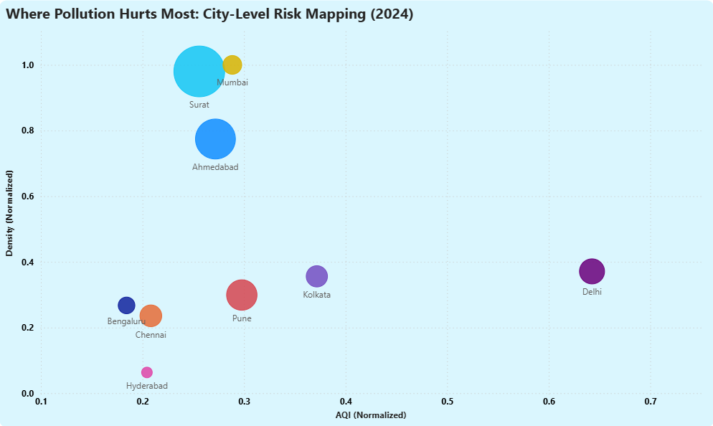
City risk scores
(AQI severity × population density × income)
Notes:
City risk scores.
City Score is pollution risk at the city level, calculated using normalized AQI (2024), Population Density(2024) & Per Capita Income(2024).
Bubble size represent City Risk Score.
Risk Score = AQI × Density × (1 – Income) × 100
Why 1-Income ➔ turning high income into lower vulnerability & low income into higher vulnerability.
Higher per capita income means ➔ Better access to healthcare, Cleaner living conditions, Ability to afford mitigation tools (e.g. air purifiers)
So, in risk modelling, high income = less vulnerable ➔ That's why we subtract it from 1:
Key Observations:
Surat stands out with a large bubble indicating high population density & moderate AQI, but a very high-risk score (276.46) due to low per capita income making it the most vulnerable city. Ahmedabad also shows a prominent Risk Score driven by moderately high AQI & density combined with low income.
In contrast, Mumbai, despite having the highest density, shows a relatively small Risk Score owing to its high income, which reduces vulnerability.
Delhi, with the highest AQI falls mid-range on density and risk score.
Cities like Hyderabad & Bengaluru shows lower overall risk due to lower pollution or density.

Slide 22
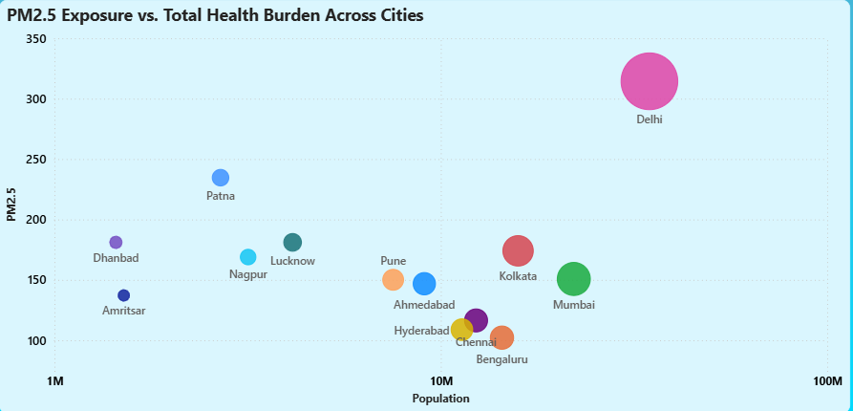
Health cost impact projections
Notes:
Health cost impact projections.
Key Observations:
Delhi shows the highest health burden due to both extremely high PM2.5 levels (314 μg/m³) & largest population (3.4 crore).
Mumbai & Kolkata also show significant health burdens due to their large populations & high PM2.5.
Smaller cities like Dhanbad & Patna have very high PM2.5 exposure but lower absolute health burden due to smaller population size.
Bengaluru despite moderate PM2.5 has a high health burden because of its large population.
Amritsar & Nagpur even though have high pollution levels but relatively lower burden because of small population size.
## Calculation: Estimated economic health burden (₹ thousand crore) due to PM2.5 exposure, calculated as ₹2,000 per person per 10 μg/m³ PM2.5 increase, scaled by city population based on models from World Bank, Lancet and NITI Aayog.
Bubble size Health Cost Burden (Cr).

Slide 23
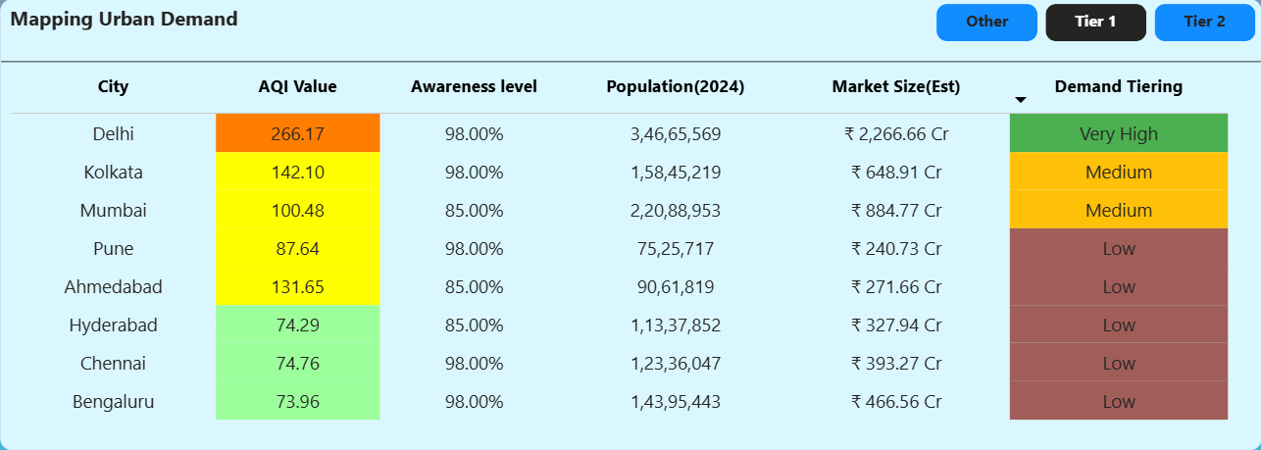
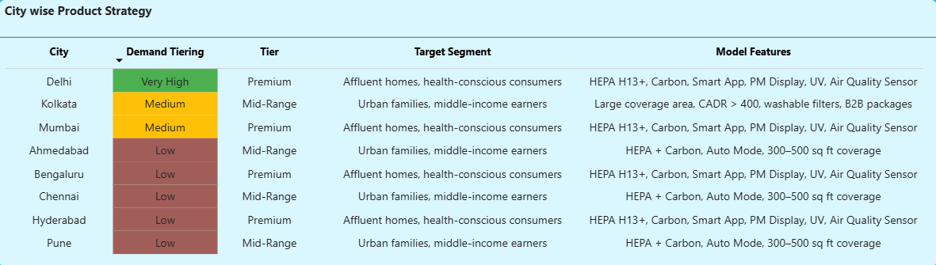
Urban Demand Index & Revenue Opportunity
Notes:
Urban Demand Index & Revenue Opportunity.
Key Insights:
High AQI alone doesn't ensure High Demand.
Cities like Amritsar or Dhanbad may have severe pollution but low market potential due to smaller populations & low awareness.
Estimated demand is influenced by Population size & Awareness levels ➔ cities with large aware populations (like Delhi or Mumbai) score higher despite others having worse AQI.
Cities are tiered by market potential and matched with customer segments and tailored product features.
# Calculation:
Demand index blends AQI (50%), population (30%) & awareness (20%).
Market size (₹ Cr) estimated using population, demand index 8% penetration(Target population) and ₹10,000 unit price.
Sales potential scored using demand index (60%) & normalized market size (40%), classified into 5 bucket. Link for Power BI Report: https://app.powerbi.com/view?r=eyJrIjoiMjkxZjA3ZDAtNTFiNC00ZDA1LWEzOGYtOWNjYzQwMWMxYzQzIiwidCI6ImRmZWFlMGYzLTNlNmItNDRlNC1iNWVmLTRjZDBjZjQ4YTQ0MCJ9

Slide 24
Pricing Strategy
AQI & Pollution Type:
High pollution levels (especially PM2.5/NO₂) justify premium pricing because of advanced filtration features.
General Awareness:
Cities with higher awareness demand smart feature-rich models, supporting higher price points.
Per Capita Income:
Higher income levels indicate greater price elasticity, increasing acceptance of premium or mid-tier models.
Population & Demand Index:
Larger populations & high demand indicate scalable markets, enabling volume-based pricing and better margins.

Slide 25
Final Recommendation Before Production & R&D.
🎯 Focus Cities
Primary Launch Cities (Very High Sales Potential/Tier 1): Delhi.
Strong AQI + High Awareness + Large Market Size = Very High Demand. Launch premium models here.
Secondary Focus Cities (Medium Sales Potential): Mumbai, Kolkata.
Balanced awareness & market size make these good for Tier 2 rollouts.
Monitor & Reassess: Patna, Lucknow.
Despite high AQI these cities currently have low demand due to: Low awareness, Limited population reach.
Reconsider for future expansion post-awareness campaigns.
Tiered Pricing:
Tier 1: Premium models (HEPA + Carbon + optional filters). Tier 2/3: Mid-range or compact purifiers.
Filter Strategy:
PM2.5/Dust: HEPA + Carbon. Gases/VOCs: Add Cold Catalyst.
Coastal (e.g., Chennai, Mumbai): Dehumidifier or anti-corrosive filters.
Boost Awareness: Run campaigns in low awareness cities like Amritsar, Varanasi, Dhanbad to unlock demand.
Data-Driven Expansion: Align Market strategy with Sales Potential Score, not just pollution levels.

Slide 26
Should Invest & Manufacture? – Recommendation.
✅ Yes, with a Phased Strategy.
Why Invest.
Delhi stands out with very high demand (high AQI, awareness and large market).
Mumbai, Kolkata, Ahmedabad offer medium-risk, high-return opportunities.
Proceed with Caution In ➔ Patna, Lucknow, Dhanbad ➔ Severe AQI but low awareness or constrained market size. Not ready for full-scale investment target via marketing & education.
Varanasi, Amritsar ➔ Low population + low awareness = poor ROI for manufacturing scale.
Partnerships: Collaborate with retail chains, hospitals, and health organisations for fast market feedback.
Recommended Approach.
Phase 1: Small-batch manufacturing focused on Delhi, Kolkata, Ahmedabad, Chennai, Mumbai.
Phase 2: Scale up based on real sales + awareness improvement.

Slide 27
Thanks To
Codebasics Team, Dataful, Dhaval Patel, Hemanand Vadivel For Organizing Challenge.

